Slide 1
Data consolidation
L-IFT Data Team

Slide 2
Data consolidation objectives
Data consolidation is a cleaning process to ensure clean and consistent data
The objectives are as follows:
Data consistency
No duplication
Timeliness
Completeness
Uniformity
Availability
Remove duplicates
Compare data between consolidations
Additional tests
Ensure no missing data or gaps
Identify sources of missing data ( e.g. zeros)
Fill the data gaps
Ensure that data is updated regularly
This is the main purpose of consolidation
Uniformity between consolidations
Uniformity across countries
Ensure data is accessible by all required parties
Use Google sheets

Slide 3

Entire data pipeline
Analysis
Data from Field
Cloud plan data
Finbit data
Consolidation
Bi-weekly
Queries
The data pipeline from the time data is collected to the final analytics
The process is cyclical and repeated biweekly

Slide 4

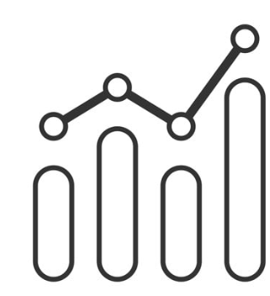





Consolidation process
Inputs
Data cleaning (preprocessing)
Outputs
(availability)
income
expense
Performance metrics
loans
Clean data
Data checks
Tests
Combined data
Assign rounds
Additional columns
Remove duplicates
Add zeros (completeness)
Consistency tests
Timeliness
accuracy
Savings

